Slide 1

For internal use only. Not to be shared or distributed outside of AstraZeneca. 3170305 10/15

Slide 2
PLACEHOLDER FOR VIDEO SEGMENT 1
~6:36
For internal use only. Not to be shared or distributed outside of AstraZeneca. 3170305 10/15

Slide 3

5 MINUTE COUNTDOWN CLOCK
BUSINESS UNIT
PERFORMANCE UPDATE
For internal use only. Not to be shared or distributed outside of AstraZeneca. 3170305 10/15

Slide 4
PLACEHOLDER FOR VIDEO SEGMENT 2
~5:31
For internal use only. Not to be shared or distributed outside of AstraZeneca. 3170305 10/15

Slide 5

9 MINUTE COUNTDOWN CLOCK FOR iCVA REVIEW – SINCE THE DSM WILL NAVIGATE AWAY FROM THIS PAGE THE COUNTDOWN CLOCK IS NOT POSSIBLE
For internal use only. Not to be shared or distributed outside of AstraZeneca. 3170305 10/15

Slide 6
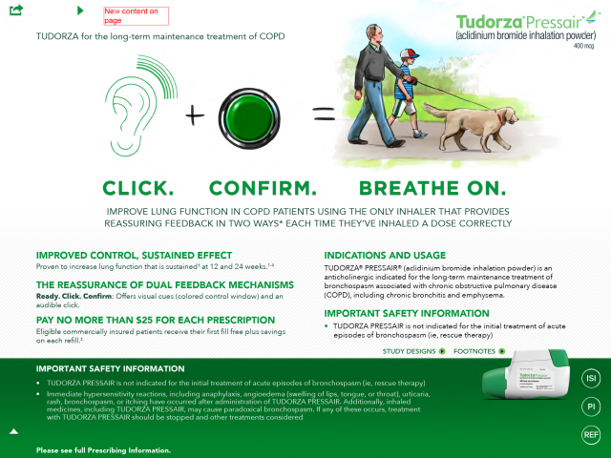
FPO

Slide 7
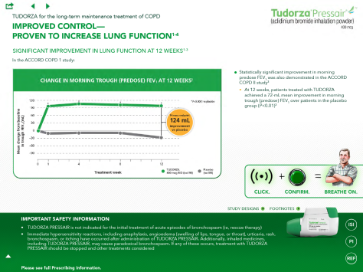
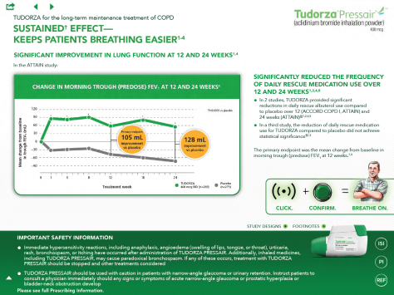
FPO

Slide 8
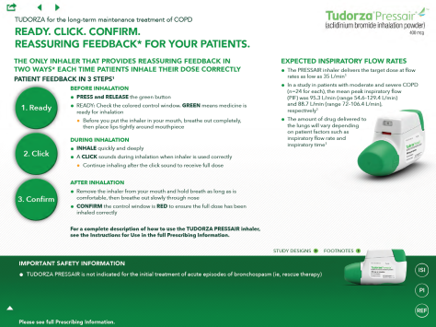
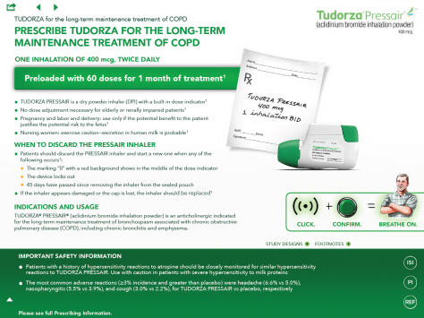
FPO

Slide 9
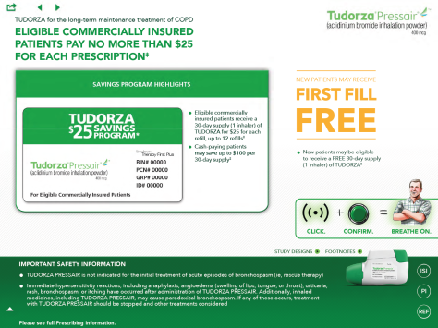
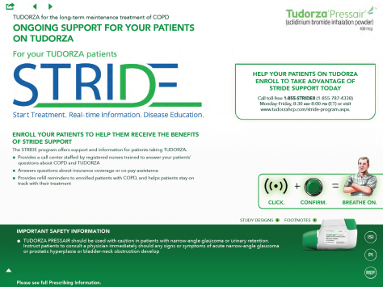
FPO

Slide 10
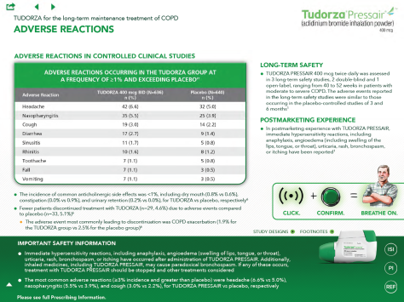
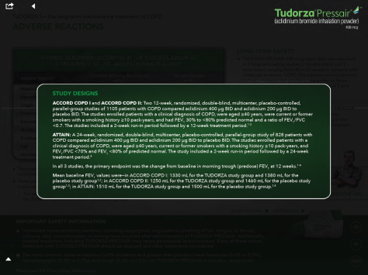
FPO

Slide 11
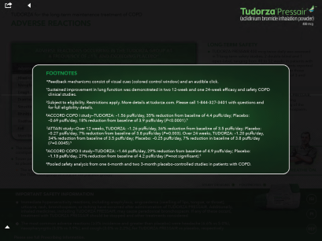
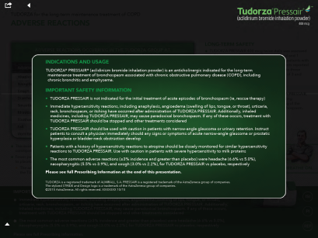
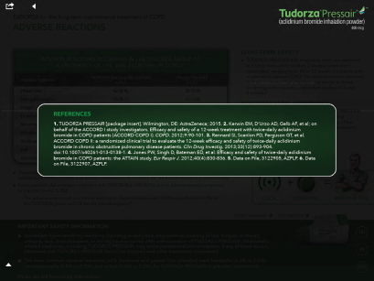
FPO

Slide 12
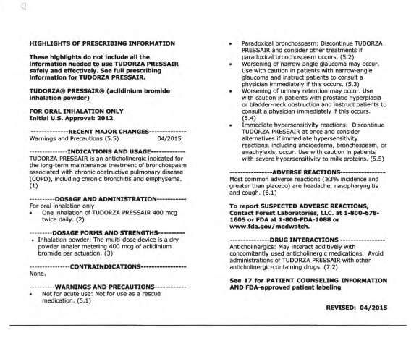
FPO

Slide 13

Navigate the iCVA
6 MINUTE COUNTDOWN CLOCK FOR iCVA NAVIGATION
FPO

Slide 14
PLACEHOLDER FOR VIDEO SEGMENT 3
~6:56
For internal use only. Not to be shared or distributed outside of AstraZeneca. 3170305 10/15

Slide 15
Click, Confirm & Deliver Navigation Challenge
10 MINUTE COUNTDOWN CLOCK FOR ACTIVITY - SINCE THE DSM WILL NAVIGATE AWAY FROM THIS PAGE THE COUNTDOWN CLOCK IS NOT POSSIBLE
Head-to-head Team-based Competition
DSM assigns PSSs to two teams, Team A and Team B
Each team designates one PSS’s iPad as the buzzer; another PSS’s iPad as the navigation iPad
PSSs take turns competing for their team
Message/Information pops on screen (in a green circle à la iCVA), DSM reads info
PSSs from Team A and Team B navigate to the iCVA page
First PSS to buzz the buzzer gets to verbalize appropriate messaging
If the navigation and the verbalization are both correct, team wins 5 points
Game continues for remainder of the activity
Team with the most points wins

Slide 16
1. What lung function improvement was shown in the ACCORD COPD 1 Study?

Slide 17
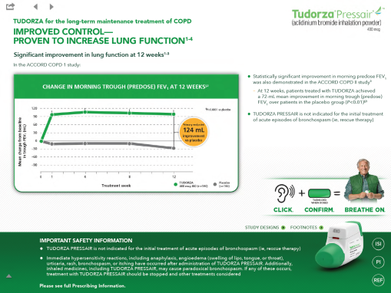
FPO
(v23)

Slide 18
2. What post-marketing experience is there with TUDORZA?

Slide 19
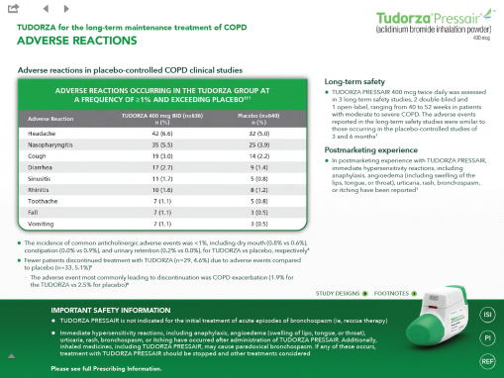
FPO
(v23)

Slide 20
3. What lung function improvement was shown in the ATTAIN Study?

Slide 21
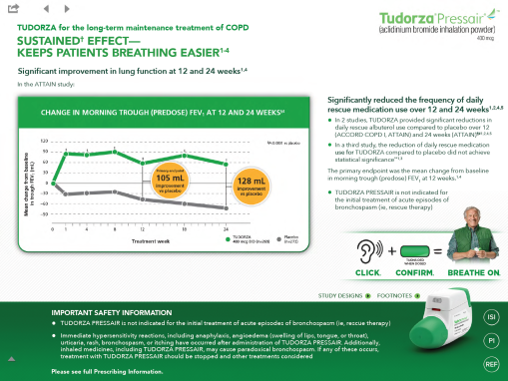
FPO
(v23)

Slide 22
4. What feedback steps are provided during inhalation of TUDORZA PRESSAIR?

Slide 23
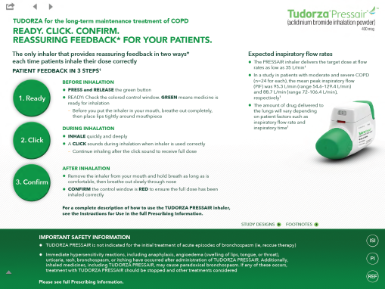
FPO
(v23)

Slide 24
5. What is the dosing information for TUDORZA?

Slide 25
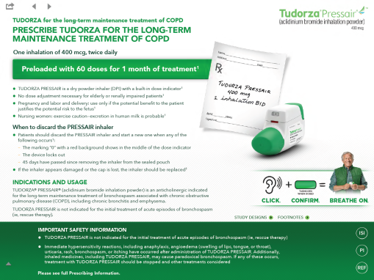
FPO
(v23)

Slide 26
6. What are the most common adverse reactions with TUDORZA?

Slide 27
FPO
(v23)

Slide 28
7. How does the use of TUDORZA impact the use of rescue medication?

Slide 29
FPO
(v23)

Slide 30
8. What ongoing support exists for patients on TUDORZA?

Slide 31
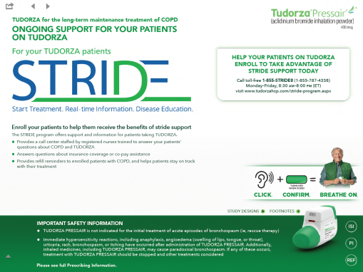
FPO
(v23)

Slide 32
9. What are the expected inspiratory flow rates with the TUDORZA PRESSAIR Inhaler?

Slide 33
FPO
(v23)

Slide 34
10. When should the PRESSAIR inhaler be discarded?

Slide 35
FPO
(v23)

Slide 36
11. What long-term safety studies were conducted for TUDORZA?

Slide 37
FPO
(v23)

Slide 38
12. What savings program exists for TUDORZA?

Slide 39
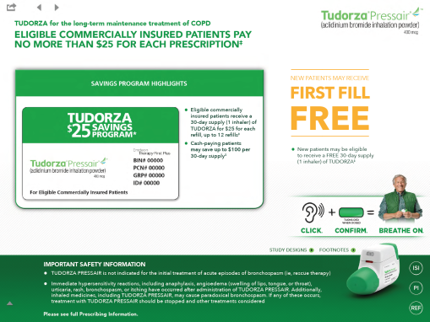
FPO
(v23)

Slide 40
13. Explain what the new campaign is communicating.

Slide 41
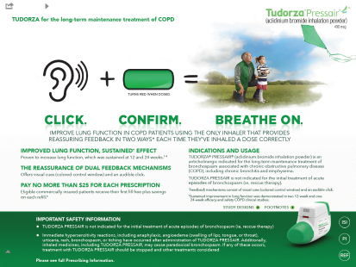

FPO
(v23)
FPO
(v23)

Slide 42
14. What adverse event most commonly leads to discontinuation with TUDORZA?

Slide 43
FPO
(v23)

Slide 44
15. A customer asks you: “Does TUDORZA have an effect on reducing COPD exacerbations? Are there data available on the use of TUDORZA for the treatment of COPD exacerbations?”

Slide 45
TUDORZA is not approved for the reduction of exacerbations in patients with COPD; therefore, I cannot address this topic. TUDORZA is indicated for the long-term maintenance treatment of bronchospasm associated with COPD. If you would like more information on this subject, I can submit a Medical Information Request (MIR) for you, provide you with the phone number for our Medical Information Department, or submit a request for a personal follow-up by Scientifically Trained Personnel (SciP).

Slide 46
16. A customer says: “My patient’s TUDORZA device didn’t work/is broken.” How do you respond?

Slide 47
I’m sorry that your patient had a negative experience with the PRESSAIR device. If your patients ever experience issues with the PRESSAIR device, please call the AstraZeneca information center at 800-236-9933 and report the issue. AstraZeneca will contact the patient’s pharmacy to arrange a replacement of their device.
Because the PRESSAIR device provides visual and audio feedback when a patient has inhaled a dose correctly, it’s important that patients know how to use the inhaler. In some cases we're learning that if patients weren't trained how to use the device, they may not use it correctly, and then they think that it may not be working properly.
Offer the HCP PRESSAIR or TUDORZA PRESSAIR practice inhalers and provide them with a demonstration of how to use the device.

Slide 48
Paired Verbalization Practice
5 MINUTE COUNTDOWN CLOCK FOR ACTIVITY
Pair off and alternate taking on the role of “PSS” and “HCP”
“PSS” navigates the iCVA while verbalizing a call open, the efficacy and safety messaging, dual feedback mechanism and close, and responding to customer feedback
At an appropriate point “HCP” interjects an RTCF
“HCP” should refer to his/her Playbook for the RTCFs
“HCP” records observations on the feedback form and provides feedback
RTCFs to be interjected
Does TUDORZA have an effect on reducing COPD exacerbations? Are there data available on the use of TUDORZA for the treatment of COPD exacerbations?
My patient’s TUDORZA device didn’t work/is broken
~2 minutes/call followed by 30 seconds of feedback

Slide 49
PLACEHOLDER FOR VIDEO SEGMENT 4
~6:18
For internal use only. Not to be shared or distributed outside of AstraZeneca. 3170305 10/15

Slide 50
THANK YOU!

